Slide 1

Akshaya, Andrew, Avery, Rachel, and Tali
Notes:
Out team name is CNN... by Akshaya...

Slide 2


Feature Extraction
01
Initial Approach and Models
02
Our Journey
Convolutional Neural Network
03
Final Model
04
Spectral_flux, ZCR, and others
Fully connected neural network and other algorithms
LOTS of trial and error
In all its glory
Notes:
This project was a pretty lengthy process. We didn’t really know where to start but after some discussion we started by extracted a wide variety of features.
Then we used these various combinations of these features and signals in a variety of models. After a lot of trial we decided to move on to a convolutional neural network which presented challenges in itself.

Slide 3
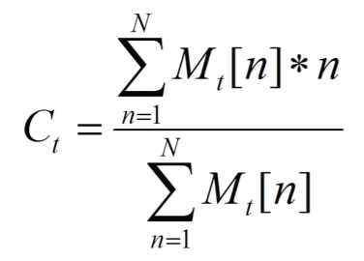
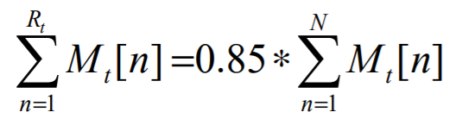
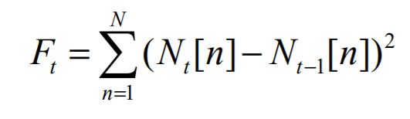
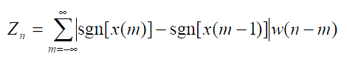
FEATURE SELECTION
FEATURE SELECTION
SPECTRAL FLUX
SPECTRAL CENTROID
SPECTRAL ROLLOFF
ZERO CROSSING RATE (ZCR)
MAXIMUM AMPLITUDE
“Squared difference between the normalized
magnitudes of successive spectral distributions“
Location of the center of mass of the magnitude spectrum.
The frequency below which 85% of the total spectral energy lies.
Measure of how many times the raw signal crosses 0.
Calculate the max amplitude from the fourier transform.
Notes:
-First ran nn model that came with the original neural network.
-So, Picked hand engineered features from signal ML exercises that we wrote and chose which ones to use based on more research about the different signals.
-different brain waves occurred in the brain at different states of sleep, like alpha, beta, theta, delta brain waves, which were known to have different frequencies
So chose spectral centroid, which shows at which frequency the signal has the center of mass of magnitude spectrum, because we thought it would differentiate the different signals by their frequencies, making it easier for our model to learn
-But we had trouble running spectral centroid because we a got division with scalar warning, which spit out NaNs, no matter what we did, like taking the log of the spectral centroid.
-So then we chose, spectral rollof which can be used to give a good idea of what frequencies contain the majority of the energy, we thought that this feature would help differentiate the signals by frequency, now that we had no spectral centroid feature.
-Also after some research we found that several sleep states had the same brain waves, like Arousal and REM both had both Alpha and Beta brain waves,
So we figured maybe at different sleep states, these waves may have different amplitudes, so we worked to find the max amplitude for each signal. This way, we could fix any confusion the model would get while training similar frequency signals.

Slide 4
SIGNAL SELECTION
SIGNAL SELECTION
Preliminary research:
REM & Arousal brain waves near identical
Brain wave overlap among different sleep stages
EEG signals are necessary for accurate classification
Further research:
Other signals are only effective if combined with EEG signals
Notes:
In addition to selecting features, we also needed to select which signals we were extracting from
Preliminary research found:
REM & Arousal brain waves near identical
Hypothesized to be causing the low MCC values (0.2 - 0.3) as arousal and REM were being misclassified
Considering only ECG, EMG, and respiration, and different combinations produced inferior AUC & MCC values - EEG signals are necessary for accurate classification
Further research found:
EEG is the most effective classifier
EMG, EOG, and ECG are effective if and only if combined with EEG signals
Concluded that incorporating all signals would produce the most accurate model

Slide 5
Preliminary Models
Preliminary Models
MARS
High training accuracy, low validation accuracy
Prone to overfitting (high depth required)
NEURAL NETWORK
RANDOM FOREST
Validation accuracy lower than other methods
Low MCC
Many layers needed to improve results (longer runtime)
DECISION TREE
Inconsistent results and often overfit (close to 100% training accuracy and 30% validation accuracy)
Notes:
Basic neural network that was in the notebook but with various features and signals. We found that a lot of layers were needed to produce mediocre results.
Decision tree -- actually at first I was running the decision tree on the not shuffled data and I think this caused it to give really good results. However, after we switched it to running on the shuffled data, it was unable to produce a decent validation accuracy.
Similarly the random forest could become really accurate in training but would be extremely over fit as the validation accuracy hovered around 30%

Slide 6
OUR MODEL
OUR MODEL
Our observations thus far:
Feature extraction is tedious, lengthy, and requires significant research into biosignal features (ECG, EEG, EMG, etc.)
Convolutional Neural Network
Automatic feature extraction & selection hypothesized to be superior
Time efficient - hand engineering necessary
New Challenges
Less knowledge in layer parameter and structure/architecture optimization

Slide 7
Optimizing the Model
Optimizing the Model
Simple CNN produced poor, but slightly improved results
Research
2-3 Convolutional layers before diminishing accuracy increase
Layer Normalization boosts accuracy, improves time to convergence
Pooling improves generalization of convolutional layers
Experimentation
Larger filter sizes improve accuracy
Kernel size of 10 is optimal (from 3- 50)
Research & Experimentation helped bring us to our final model result
CNN Architecture
Layer Type | Size | Kernel Size | Activation
Convolutional 1D | 50 | 10 | ReLU
Layer Normalization
MaxPooling1D | 10
Convolutional 1D | 100 | 10 | ReLU
Layer Normalization
Global Max Pooling 1D
Dense | 500 |  | ReLU
Dense | 5 |  | Softmax
Dropout - 0.2

Slide 8
Splitting Data
Splitting Data
TEST
1000
ORIGINAL DATA
5000
TRAIN
VALIDATION
MOCK TEST
2500
1000
500
Notes:
Rachel

Slide 9
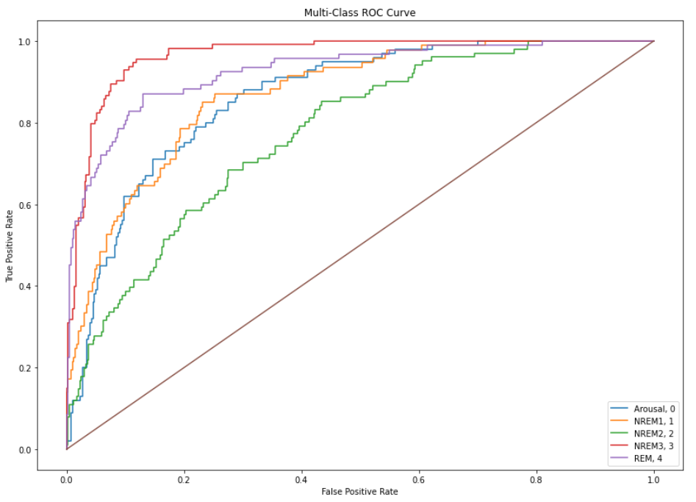
Model Performance
Model Performance
91%
55%
64%
A U C
M C C
V A L I D A T I O N
A C C U R A C Y
Notes:
Rachel
Mention interesting findings from ROC: relatively poor NREM2 classification, effective NREM3 and REM classification, arousal and NREM1 similar performance
.64

Slide 10

T H A N K S

